Slide 1


Final Year Project
Fruit Life time Prediction
Supervised By:
Muhammad Imran Khan (Senior lecturer)

Slide 2
Project Team
Muhammad Furqan 27659
Abdul-Rehman 23313
Qazi Faheem Ullah 23311

Slide 3
Table of Content
Background and Introduction
Literature Review
Problem Statement
Project Scope
Proposed Solution
Requirements Summary
Design Summary
Methodology
Implementation Summary
Experiments and Results Summary
Testing Summary
Conclusion and Outlook

Slide 4
BACKGROUND AND INTRODUCTION

Slide 5
Background and Introduction
Our project aims to revolutionize fruit classification, shelf-life detection through advanced technology. We're leveraging artificial intelligence and computer vision to address key challenges in agriculture and food industries. Our objectives include developing a system for accurate fruit classification, detecting shelf-life, identifying rotten fruits. Through automated processes and objective assessment, we strive to enhance food safety, reduce waste, and improve consumer satisfaction

Slide 6
Literature Review

Slide 7
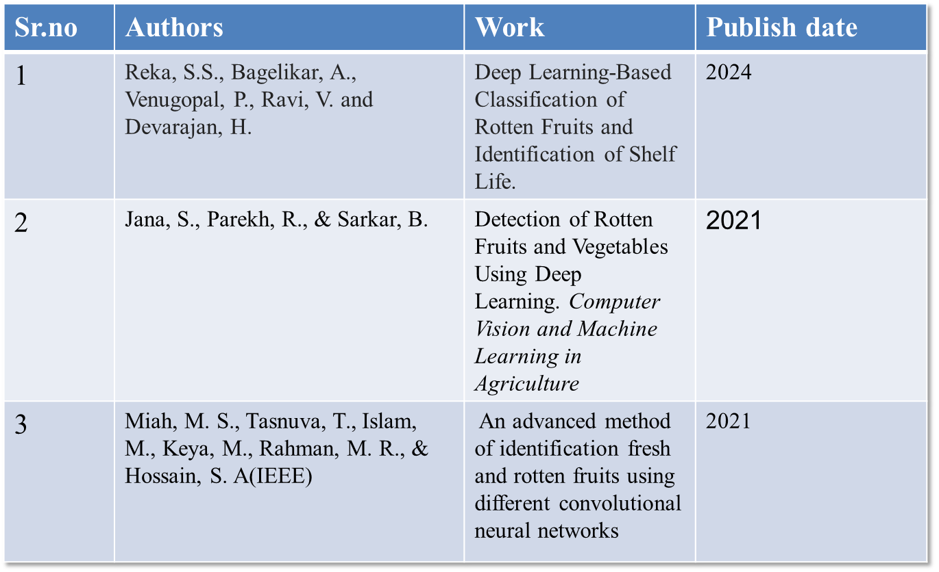
Literature Review

Slide 8
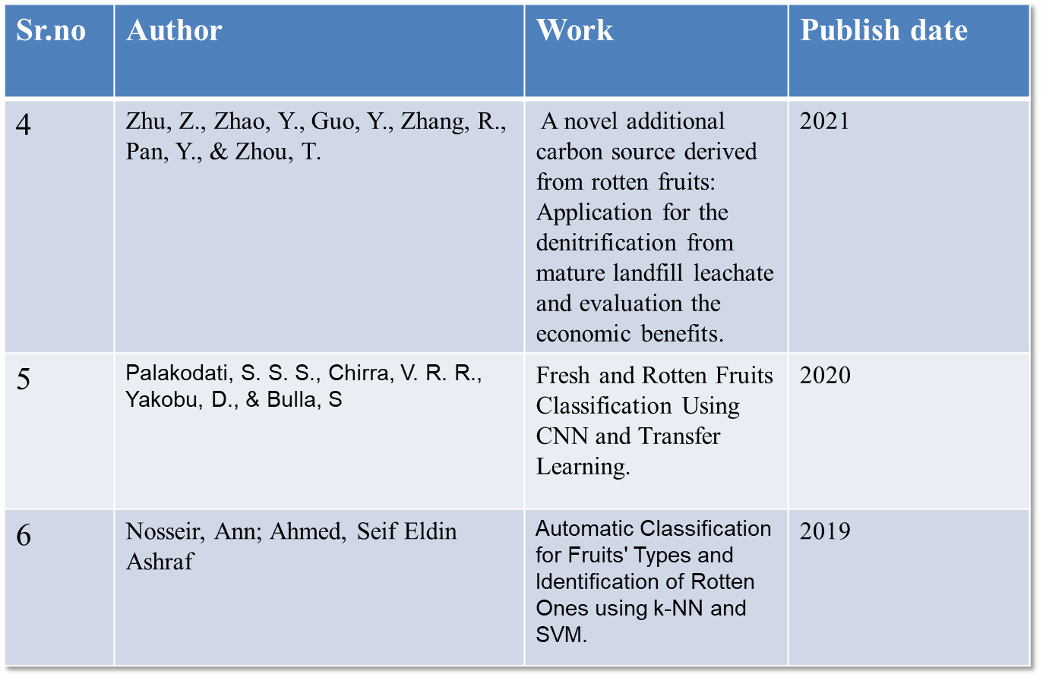
Literature Review

Slide 9
Problem Statement

Slide 10
Problem Statement
The problem: The impact of rotten fruits can foster harmful bacteria, molds and other microorganisms that can cause food poisoning and other illnesses to the consumers.
Challenge: Accurately classifying rotten fruits using computer vision technology, particularly in real-time.

Slide 11
ENDEAVOUR

Slide 12
Endeavour
Describe roles of your team members
Muhammad Furqan:
Developing Mobile Application Front End Screens
Manages Backend Development
Handles Integration of model in App
Qazi Faheem Ullah:
Handles Documentation
Found Data And Preprocessing of DataSet
Abdul-Rehman:
Manages Documentation
Train and Test AI Deep learning model

Slide 13
Endeavour
Describe your software development process
Requirement Gathering
Development
Testing
Deployment
Maintenance

Slide 14
Endeavour
Describe your way of working as a team
Collaboration
Focus on Quality

Slide 15
PROPOSED SOLUTION

Slide 16
Proposed Solution
Utilize Convolutional Neural Networks (CNNs), a deep learning model, to classify rotten fruits accurately.
Implement computer vision technology for real-time analysis of fruit images to detect signs of rot.
Develop a user-friendly application interface for easy integration into existing systems in the agriculture and food industries.

Slide 17
Requirements Summary
We have user using the Mobile Application which is consumer of Fruit
Use Cases
We have Identified Six Use Cases According to Requirements
We have six Functional Requirements
Users 6 FR’S
We have Three N-FR’S

Slide 18
Functional Requirement
FR.1: Users should be able to create an account and login to the app
FR.2: Users should be able to detect fruit through camera as well as from gallery.
FR.3: Users should be able to check the result.

Slide 19
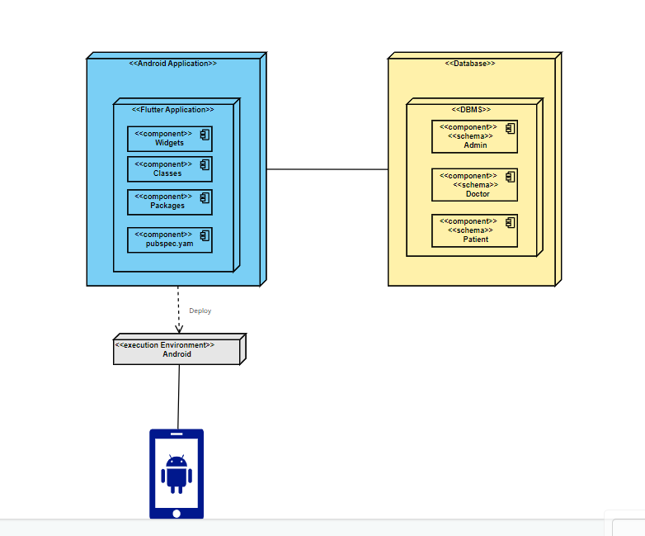
Deployment Diagram

Slide 20
Design and Methodology

Slide 21
Design Summary
Architecture diagram
Use Case Diagram
Sequence Diagram
Database Schema Diagram

Slide 22
Methodology
<Add diagram according to your project domain i.e., Methodology diagram (AI, IOT etc) OR Flow chart (Data Structures, Algorithms etc)>
<Also explain all steps in bullet points>

Slide 23
Methodology
Use of GitHub: Our Team Have used GitHub for every move very efficiently to track our change and completing process we gone through
Model Training: We trained Using CNN Sequential Model Because it is Easy to Use And it’s Basic Artitecture

Slide 24
CNN Working

Slide 25
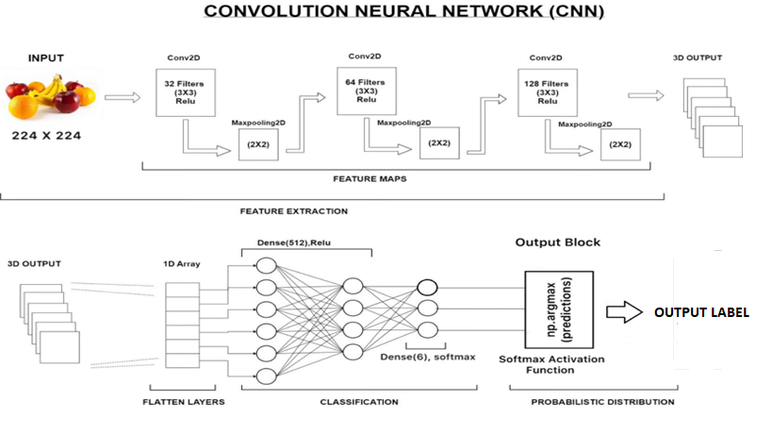
CNN Diagram

Slide 26
Implementation Summary
List of Development Technologies/ libraries
Flutter
Python
Tensor flow
Keras

Slide 27
Implementation
List of Development Tools
Android Studio
GitHub
Colab
MS Word

Slide 28
Experiments and Results Summary
We are performing different experiment on over model to check the accuracy. We can install this app on our mobile. We have use it for some day and perform some testing by capture the image through camera and the Gallery. The model show almost 80 % accuracy. We also given images other than Fruits it app shown as Unknown

Slide 29
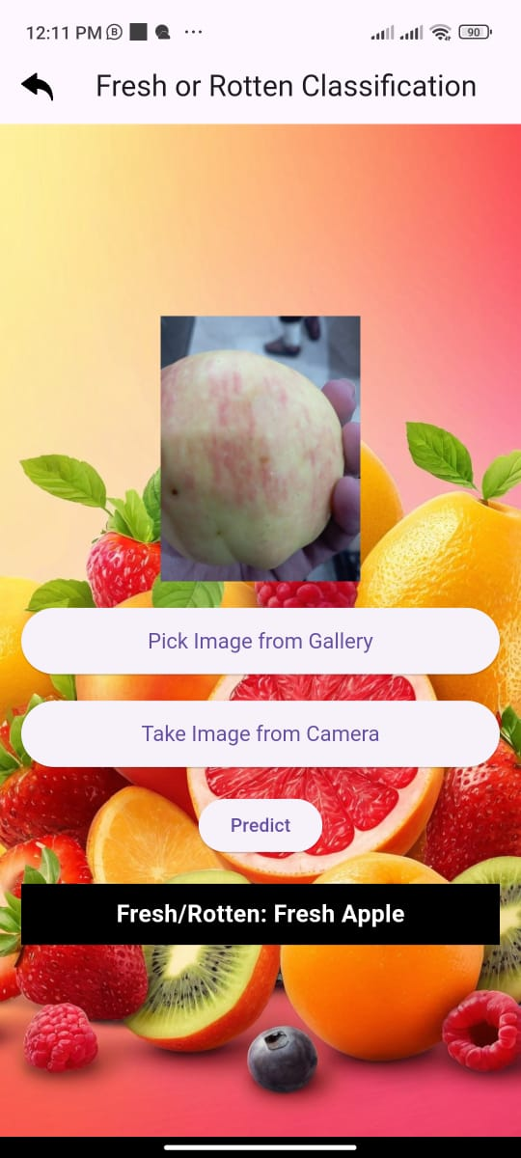
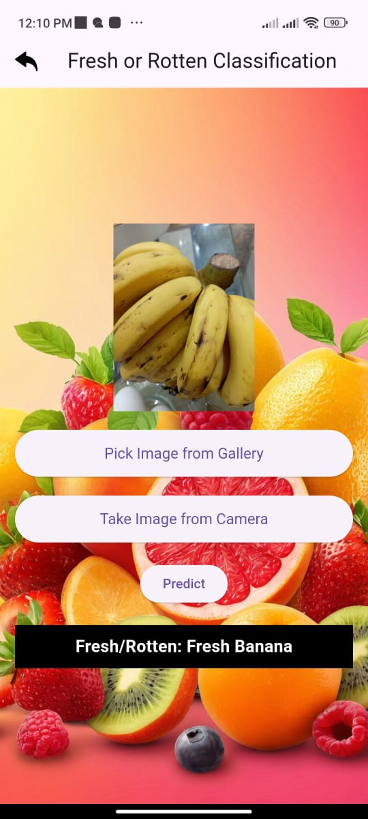
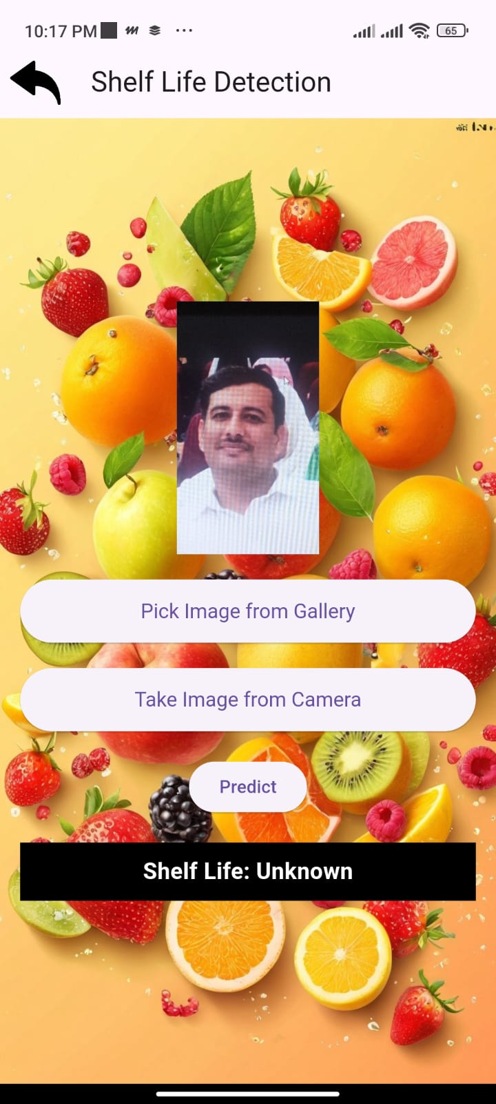
Testing Summary

Slide 30
CONCLUSION AND OUTLOOK

Slide 31
Conclusion & Outlook
Conclusion:
Fruit life time prediction app predicts fresh and rotten fruits and their shelf life
Deep learning model detects through image from camera as well as from gallery
Outlook:
Future improvements include expanding the dataset for better prediction.
We can increase number of fruits

